Slide 1
UI Presentation
Authors: fia5, jco3, dub4

Slide 2
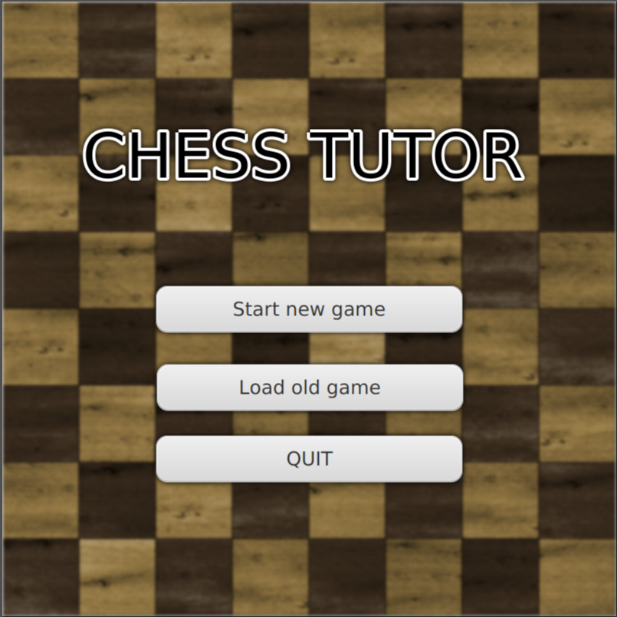
Use Case 1.1
Task 1: New Game Setup
Action: Select “Start new game”
Result: Takes the user to the player's name input screen.

Slide 3
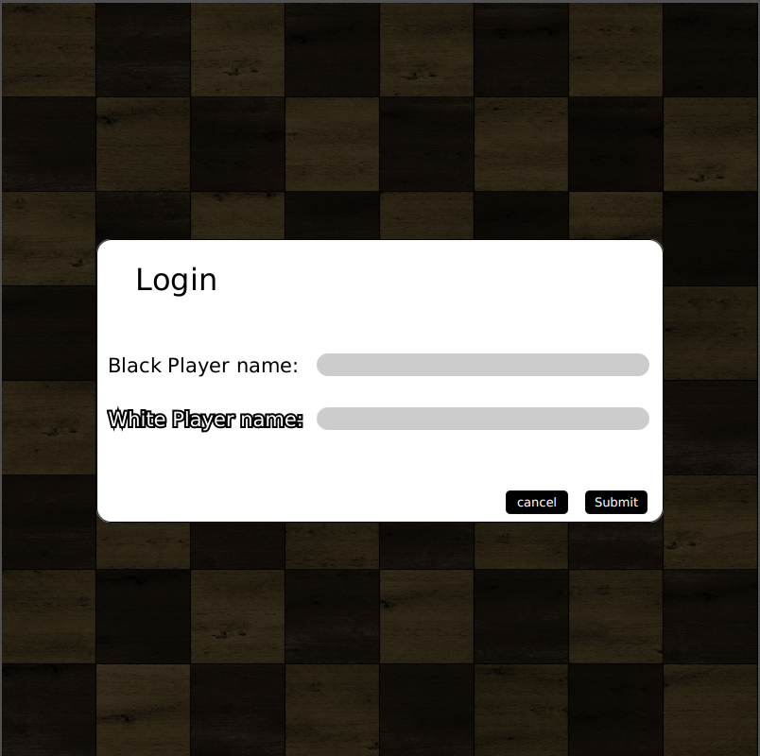
Use Case 1.1
Task 1: New Game Setup
Action: Input player names for white and black player, then press “Submit”
Result: New game is setup with input player names.

Slide 4
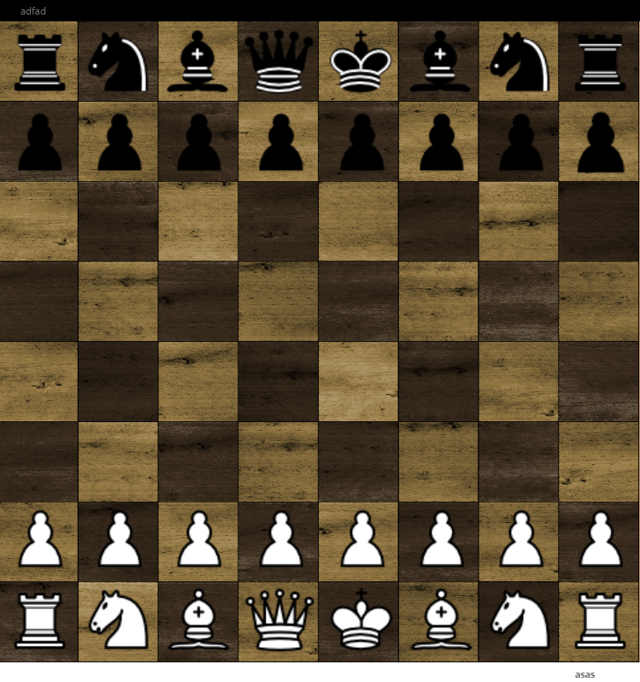
Use Case 1.1
Task 1: New game setup
Final State: upon clicking submit, the board and pieces are displayed, and the game begins

Slide 5
Use Case 1.2
Task 2: Continuing a saved game
Action: Select “Load old game”
Result: Opens the file explorer

Slide 6
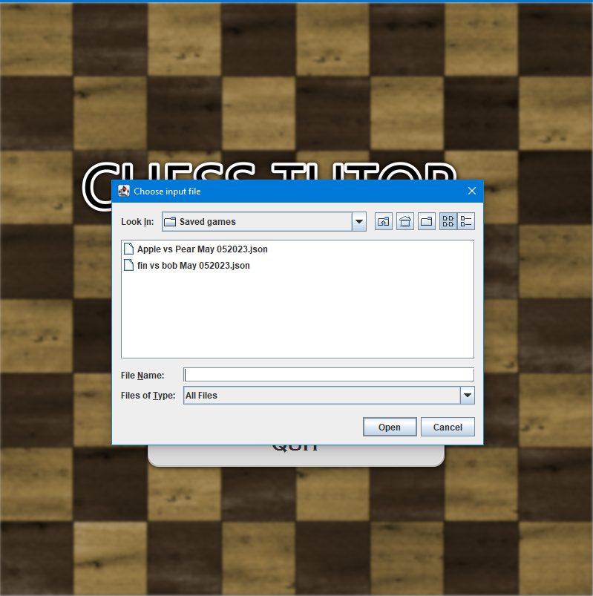
Use Case 1.2
Task 2: Continuing a saved game
Action: Select a file to load
Result: Chosen file loads onto the board
Notes:
Mock up of an open file explorer

Slide 7
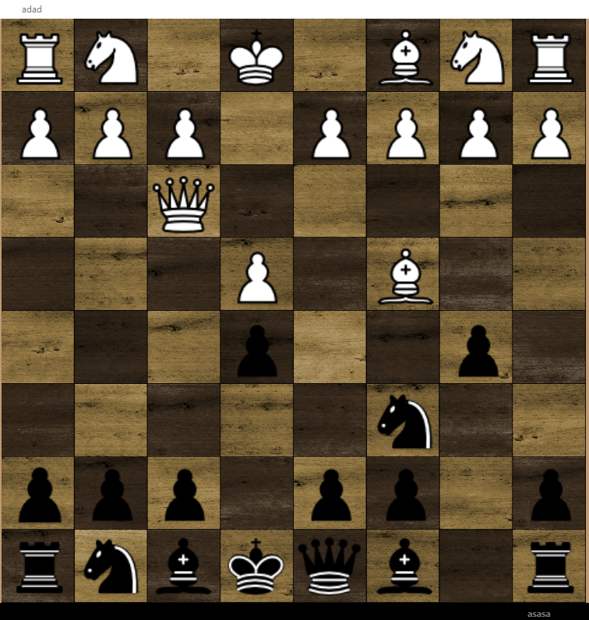
Use Case 1.2
Task 2: Continuing a saved game
Final State: Chosen files is loaded onto the board from the last played move
Notes:
Mock up of a game part way through

Slide 8
Use Case 1.2
Task 3: Replaying a saved game
Action: Select “Load old game”
Result: Opens the file explorer

Slide 9
Use Case 1.2
Task 3: Replaying a saved game
Action: Select a file to load
Result: Chosen file loads onto the board from the initial state of the game
Notes:
Mock up of an open file explorer

Slide 10
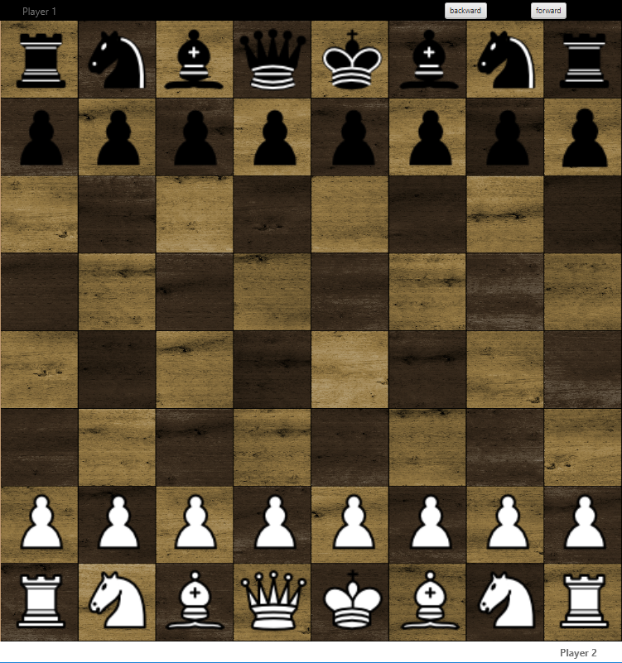
Use Case 1.2
Task 3: Replaying a saved game
Action: User presses the “Forward” / “Backward” buttons to move through the replay
Result: Appropriate move is played and displayed on the board
Notes:
Mock up of the first move of the game being displayed

Slide 11
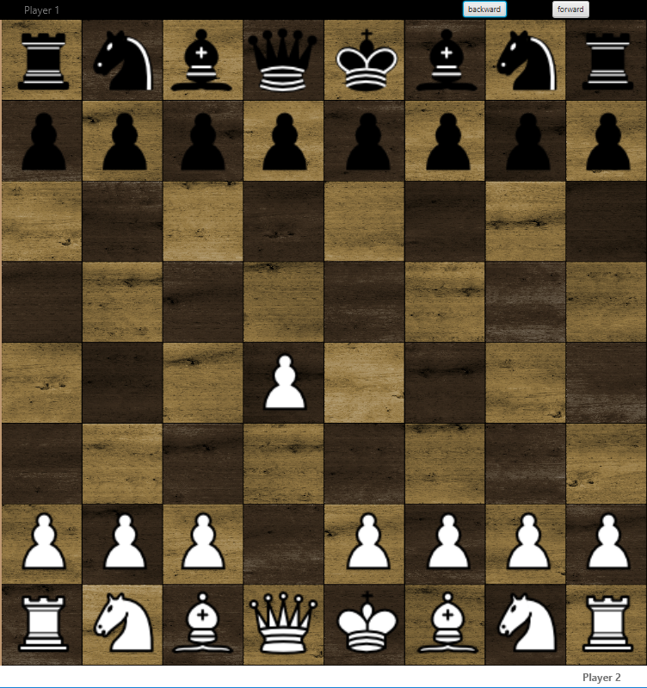
Use Case 1.2
Task 3: Replaying a saved game
Final state: Final move is played, and pop-up displays who won.
Notes:
Mock up of the first move of the game being displayed

Slide 12
Use Case 1.3
Task 4: Exiting the Game
Action: Select “QUIT”
Result: Application closes

Slide 13
Use Case 1.3
Task 4: Exiting the Game
Final State: Application has been closed
Notes:
Blank screen, demonstrating the closed application

Slide 14
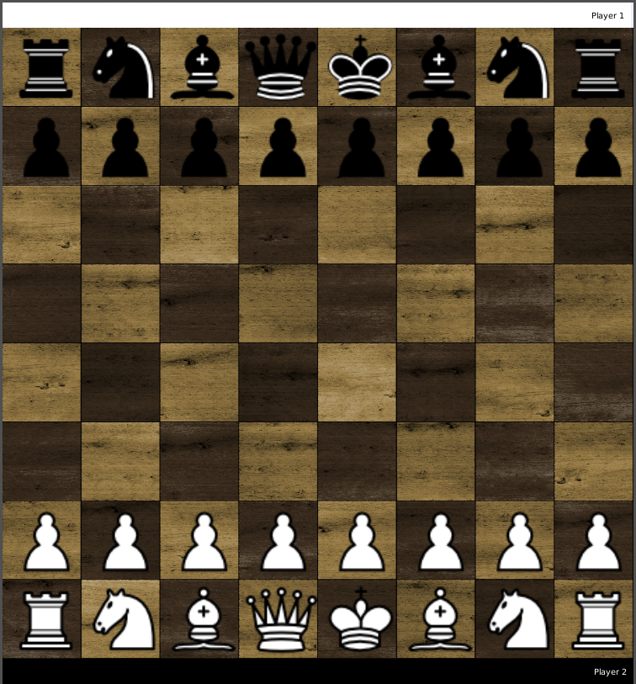
Use Case 2.1
Task 5: Selecting a Piece
Action: Current player selects a piece
Result: Selected piece is highlighted

Slide 15
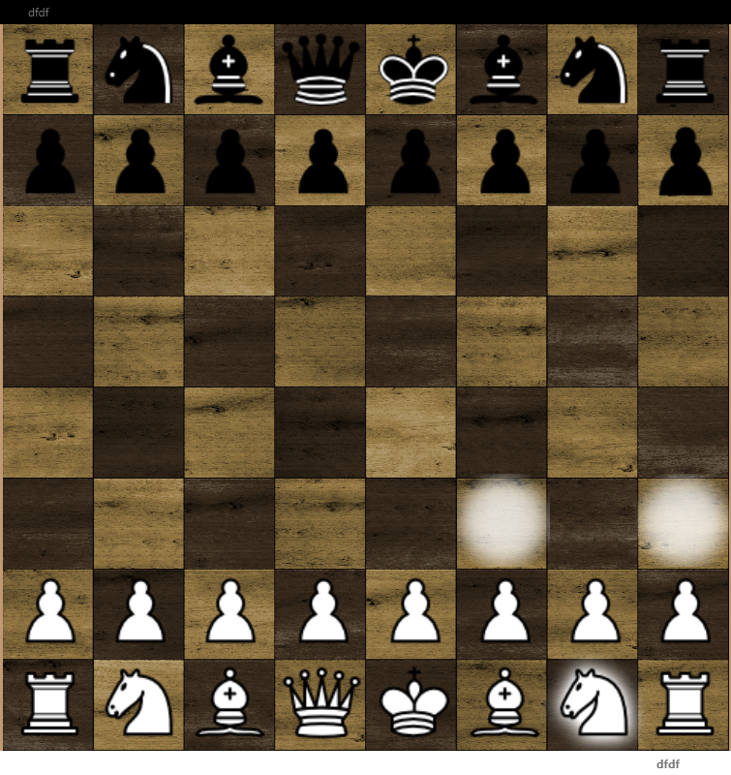
Use Case 2.1
Task 5: Selecting a Piece
Final State: Selected Piece displays all legal moves
Notes:
Asset showing:
Selected piece is highlighted Yellow
Empty Squares are highlighted Grey/White
Pieces to take are highlighted Red

Slide 16
Use Case 2.2.1
Task 6: Moving to an empty space
Action: User selects a piece (Task 5). User selects an empty square (Highlighted Grey)
Result: Selected piece moves to the selected square.
Notes:
Asset showing all legal moves for a piece where it can move to an empty square (Grey)

Slide 17
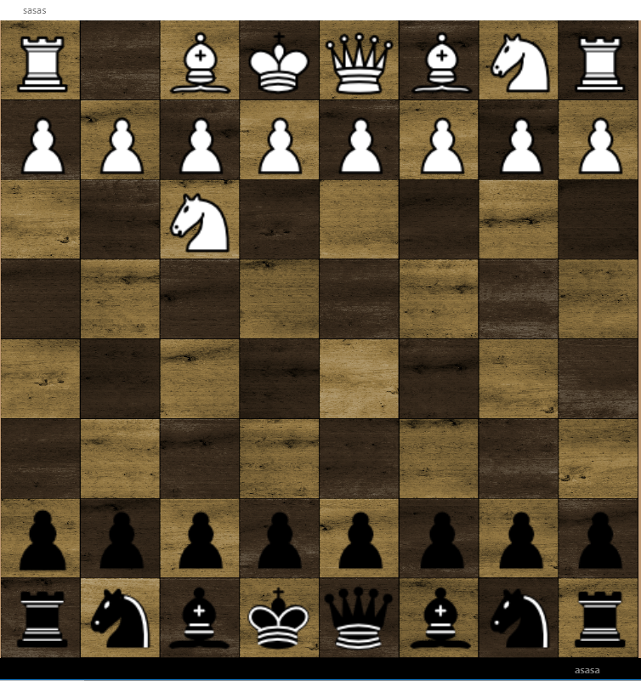
Use Case 2.2.1
Task 6: Moving to an empty space
Final State: Selected piece is moved, and the board rotates to indicate the next player’s turn.
Notes:
Asset showing the moved piece and the board being rotated.

Slide 18
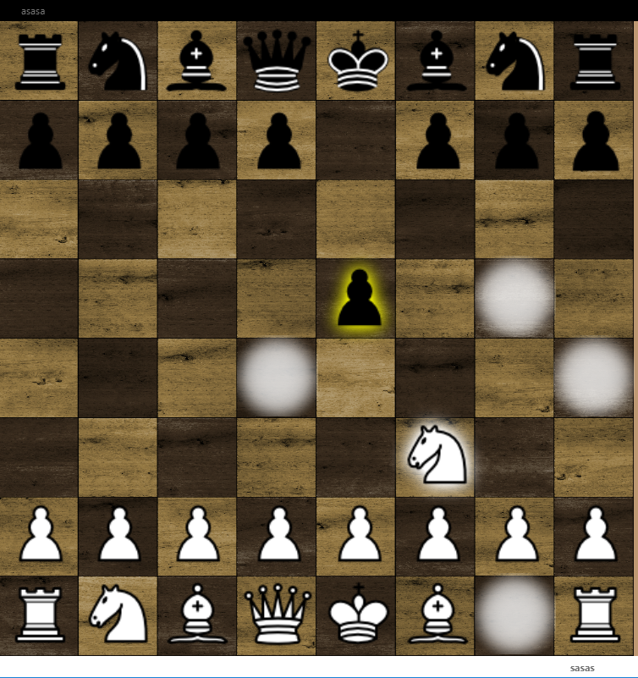
Use Case 2.2.2
Task 7: Taking a piece
Action: User selects a piece (Task 5). User selects an opponent's piece to take (Highlighted Yellow)
Result: Selected piece is moved to the selected square, removing the opponents piece
Notes:
Asset showing all legal moves for a piece where by it can take another piece. (Red)

Slide 19
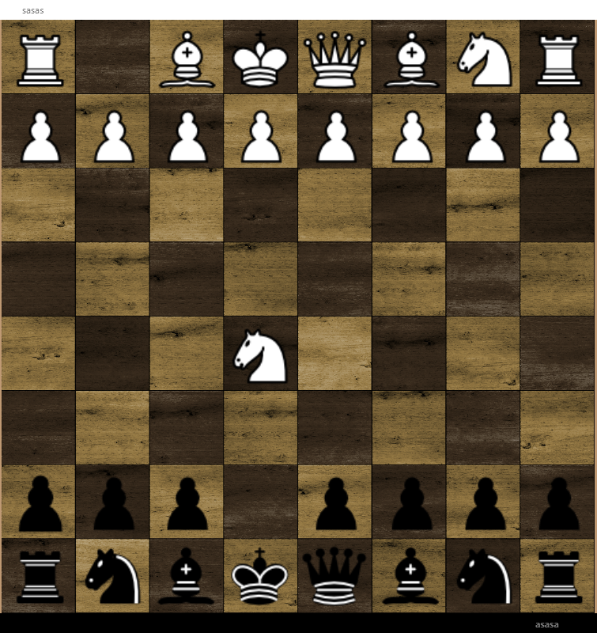
Use Case 2.2.2
Task 7: Taking a piece
Final State: Selected piece is moved, and the board rotates to indicate the next player’s turn.
Notes:
Asset showing the moved piece and the board being rotated.

Slide 20
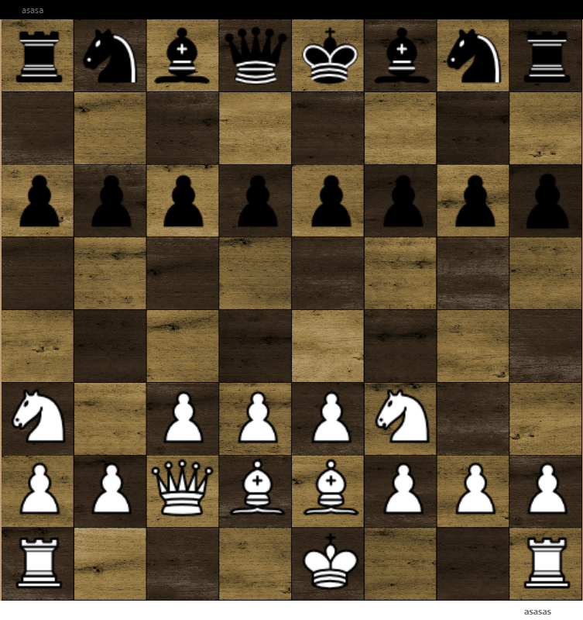
Use Case 2.2.3
Task 8: Castling
Action: User selects the king
Result: All legal moves are displayed
Notes:
Asset showing a legal position for castling, however the king has not been selected yet.

Slide 21
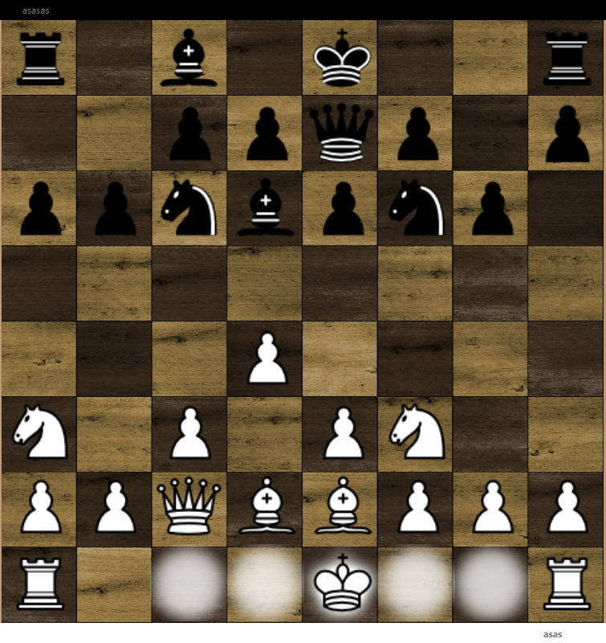
Use Case 2.2.3
Task 8: Castling
Action: User selects the castling square
Result: King moves two squares towards the Rook. Rook moves to the other side of the king.
Notes:
Asset showing the king selected and all legal moves (Castling square [Two away from king] Highlighted green)

Slide 22
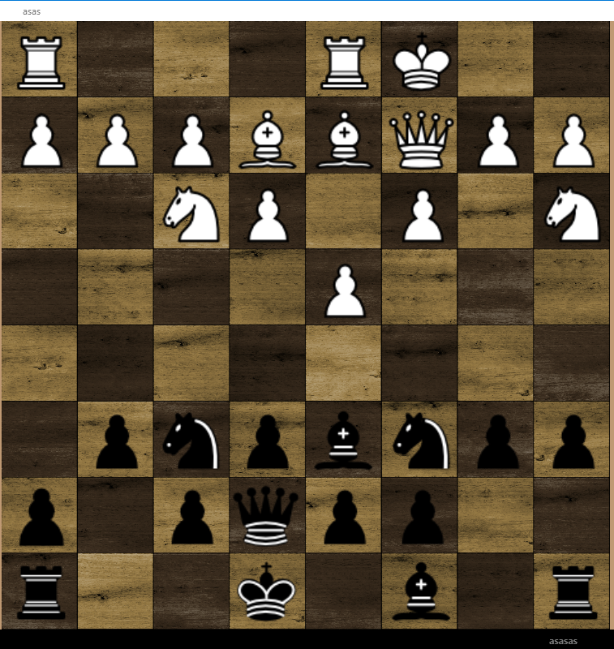
Use Case 2.2.3
Task 8: Castling
Final State: The King and Rook move accordingly, and the board rotates to indicate the next player’s turn.
Notes:
Asset showing King and Rook in correct positions and the board being rotated.

Slide 23
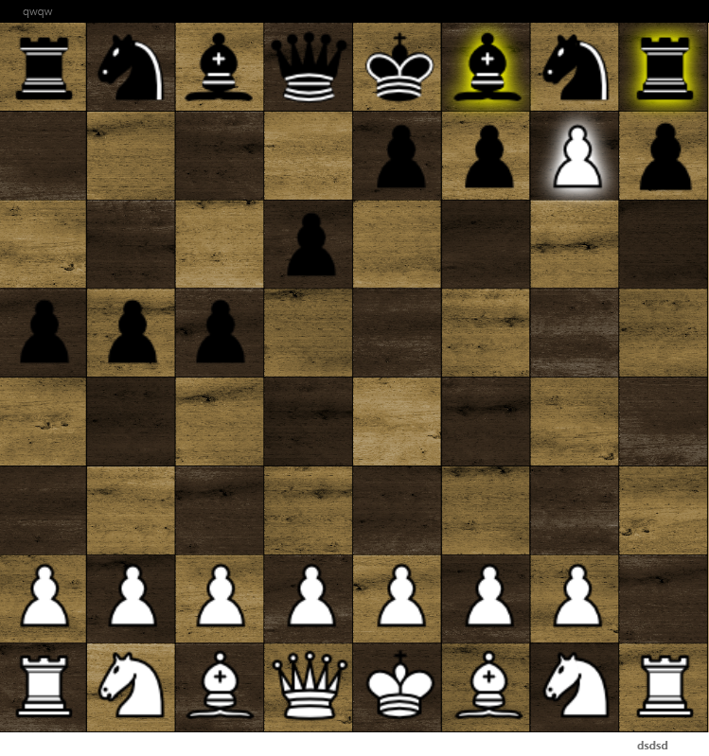
Use Case 2.2.4
Task 9: Pawn Promotion
Action: User moves a pawn on to the penultimate rank (Task 6, 7 or 10)
Result: Pop-up appears to promote the pawn.
Notes:
Asset showing the Highlighted legal moves for a pawn to be moved the final rank (Either via empty square, taking or en passent)

Slide 24
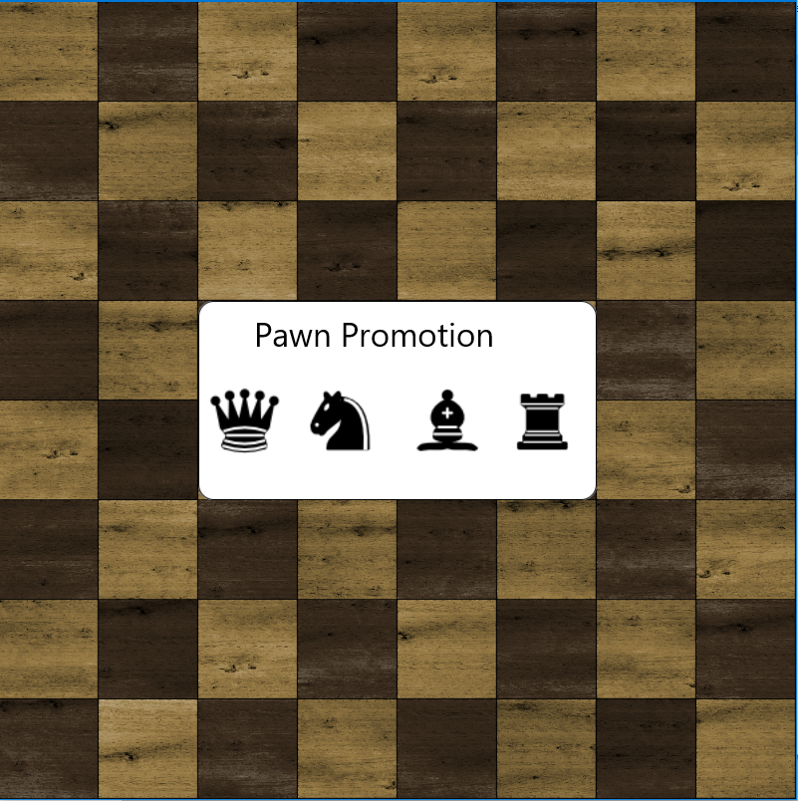
Use Case 2.2.4
Task 9: Pawn Promotion
Action: User selects a piece from the pop-up to promote the pawn to
Result: Pawn is promoted to the selected piece, and the board rotates to indicate the next player’s turn.
Notes:
Asset showing all options in the pop-up for the pawn

Slide 25
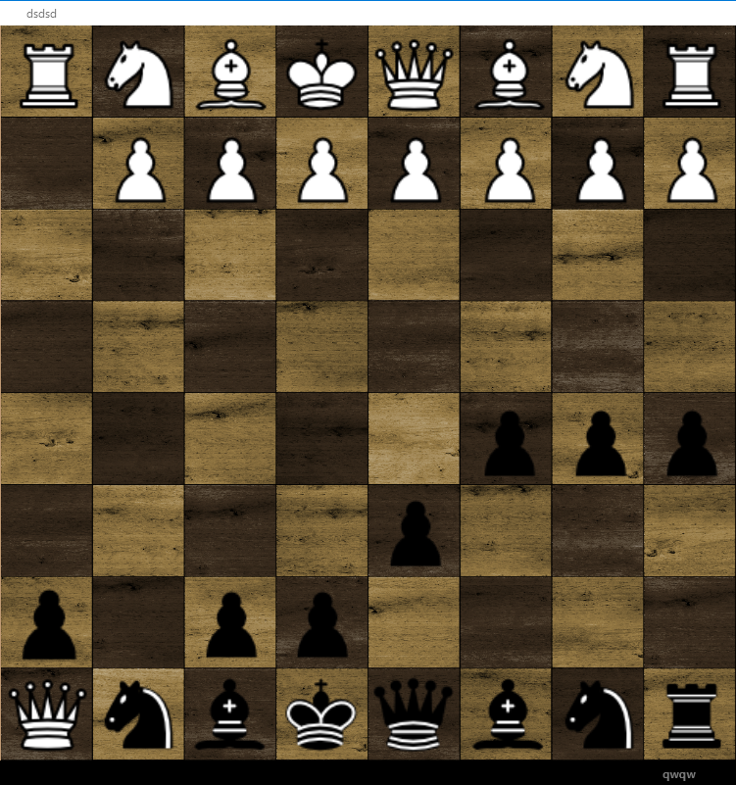
Use Case 2.2.4
Task 9: Pawn Promotion
Final State: The Pawn is promoted accordingly, and the board rotates to indicate the next player’s turn.
Notes:
Asset showing the pawn being promoted to the selected piece, and the board rotated.

Slide 26
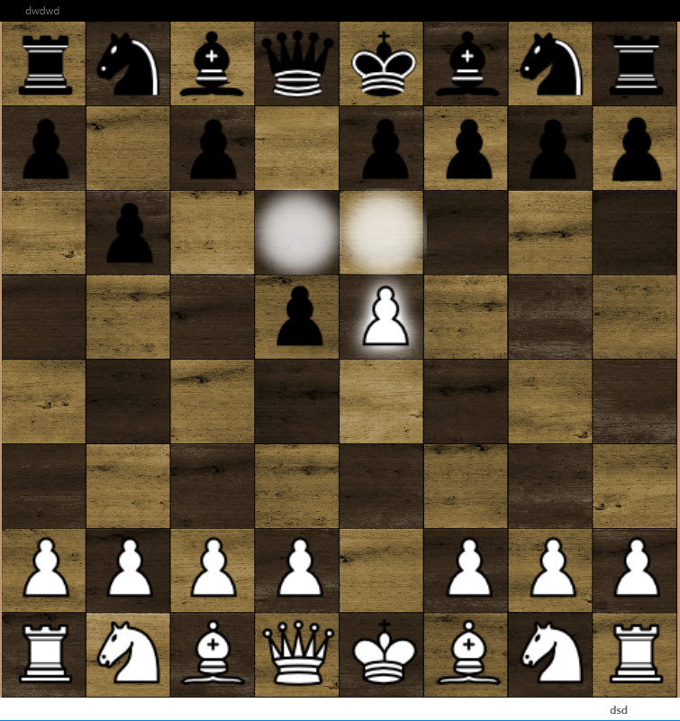
Use Case 2.2.5
Task 10: En Passent
Action: The user selects the pawn. Then the user selects the square behind the pawn.
Result: The selected pawn is moved to the selected square, removing the opponents piece.
Notes:
Asset showing the legal moves for the pawn including en passent (Highlighted Red)

Slide 27
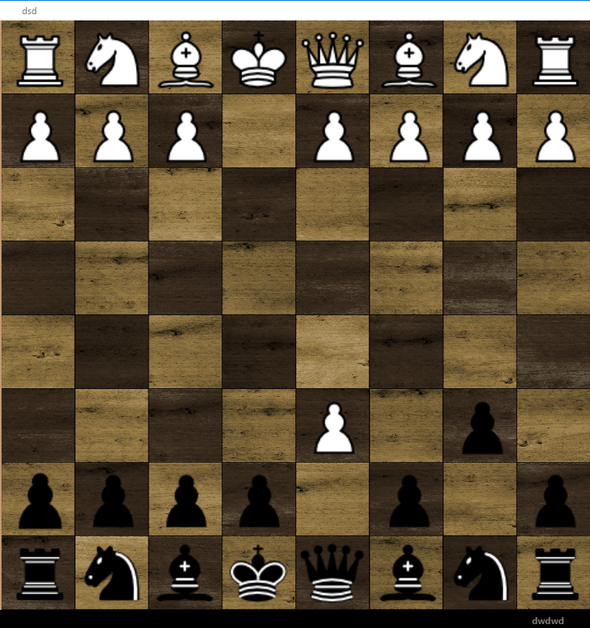
Use Case 2.2.5
Task 10: En Passent
Final State: Selected pawn is moved, and the board rotates to indicate the next player’s turn.
Notes:
Asset showing the pawn being moved to the selected square (En passent square), and the board rotated.

Slide 28
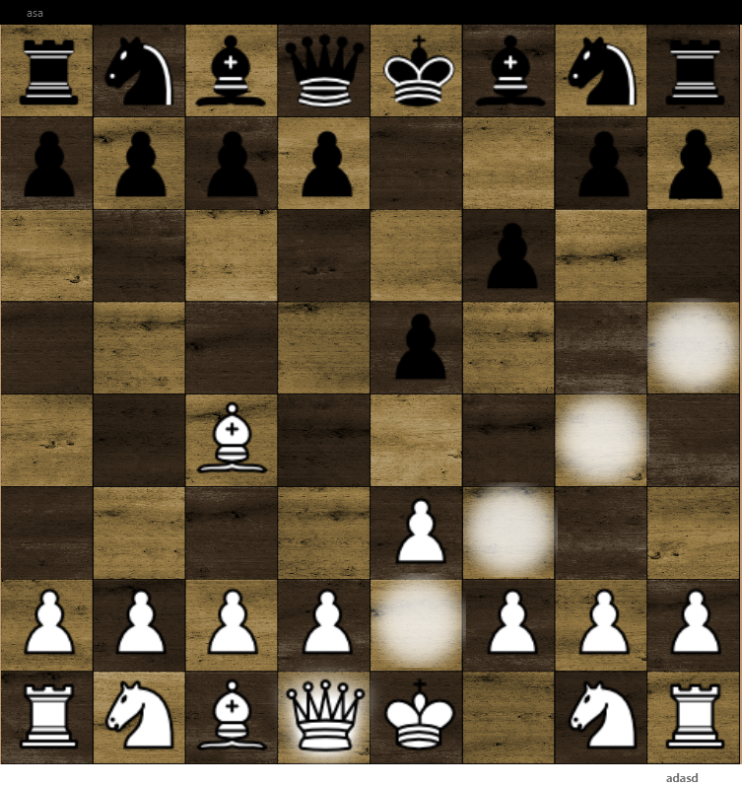
Use Case 2.2.6
Task 11: Check
Action: The user selects (Task 5) and moves a piece, threatening to take the opponent's king.
Result: King is highlighted in red, indicating it is in check.
Notes:
Asset showing a pieces legal moves, one of which will cause check (the state of the board before the king is in check)

Slide 29
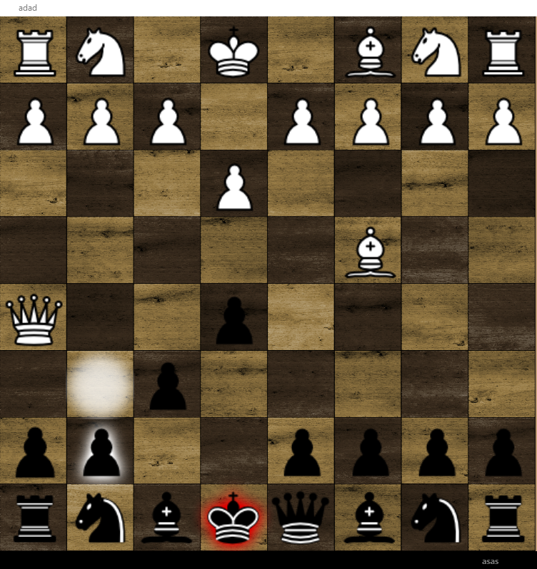
Use Case 2.2.6
Task 11: Check
Action: Opponent moves a piece (Task 6, 7, 9, 10) to avoid the threat of check.
Result: Selected piece is moved.
Notes:
Asset showing the board rotated and all legal moves for a selected piece to avoid the threat of check.

Slide 30
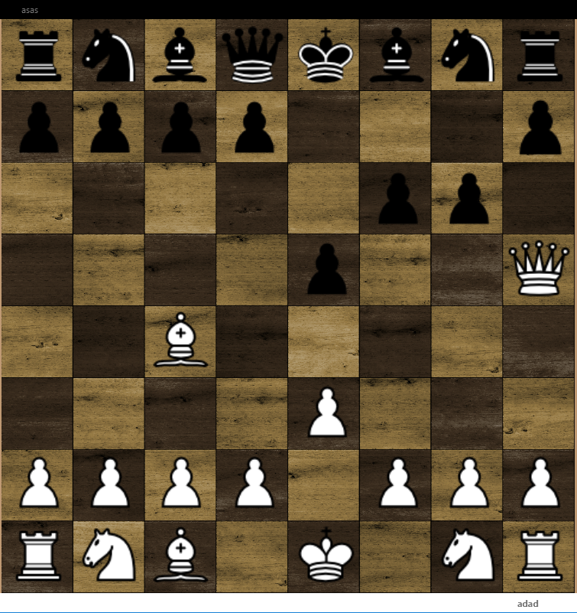
Use Case 2.2.6
Task 11: Check
Final State: The king is no longer highlighted in red.
Notes:
Asset showing the board rotated and the king no longer in check (No highlight)

Slide 31
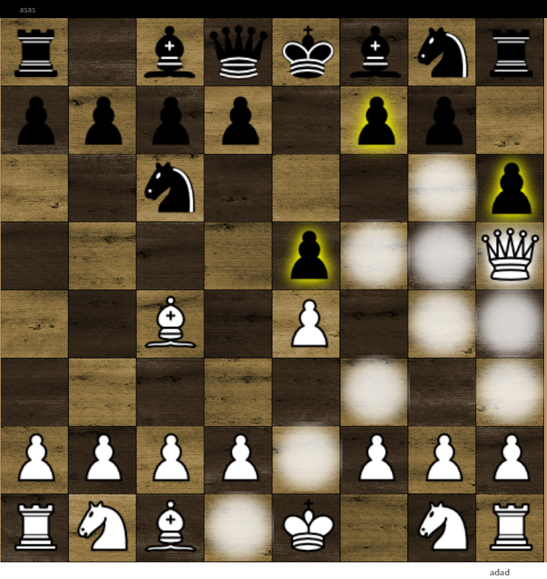
Use Case 3.1
Task 12: Checkmate
Action: The user selects (Task 5) and moves a piece, threatening to take the opponent's king.
Result: King is highlighted in red, indicating it is in check. No pieces have any legal moves to prevent the threat of check.
Notes:
Asset showing a pieces legal moves, one of which will cause check (the state of the board before the king is in check)

Slide 32
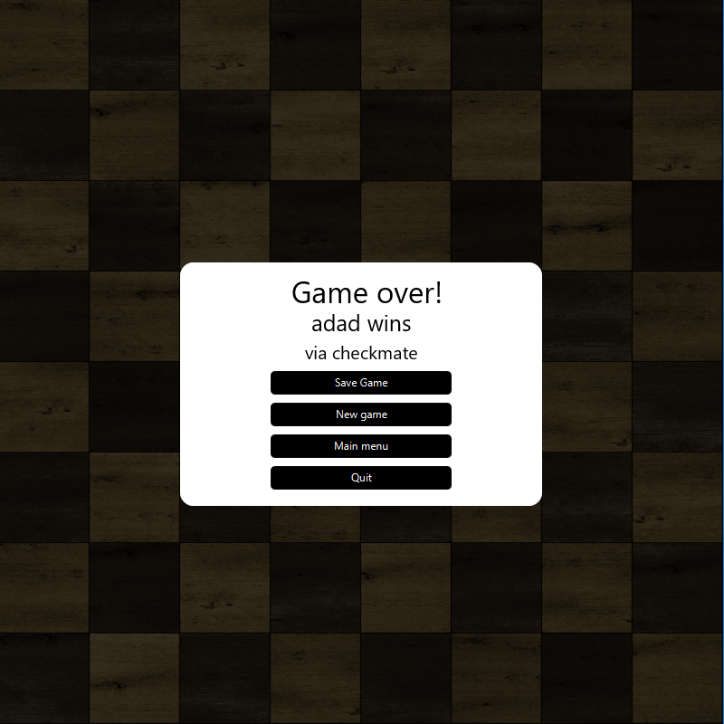
Use Case 3.1
Task 12: Checkmate
Final State: Pop-up appears displaying who won the game (Via checkmate)
Notes:
Asset showing the state of the board at checkmate with a pop-up displaying who won and how

Slide 33
Use Case 3.1
Task 13: Resignation
Action: Player presses 'ESC' key
Result: Menu appears on the screen
Notes:
Asset showing the state of the board

Slide 34
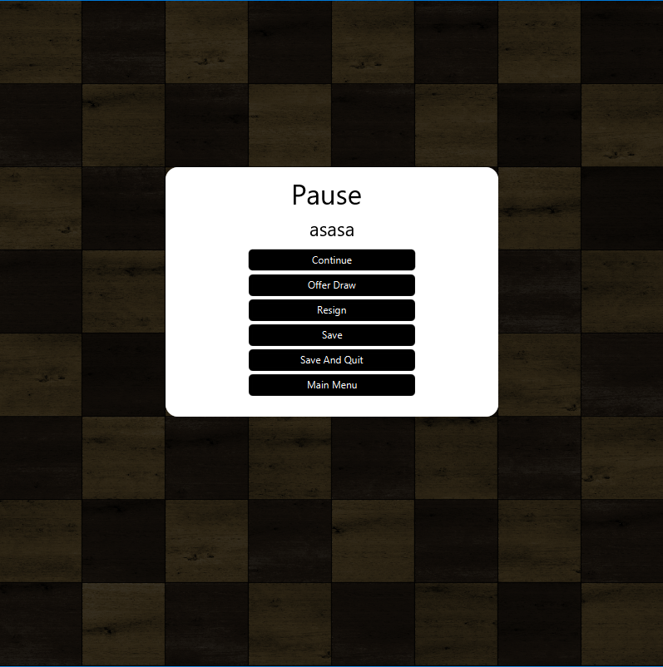
Use Case 3.1
Task 13: Resignation
Action: Player presses the "Resign" button
Result: Pop-up appears on screen.
Notes:
Asset showing the state of the board and the menu with all possible options (Resign, Offer Draw, and Quit)

Slide 35
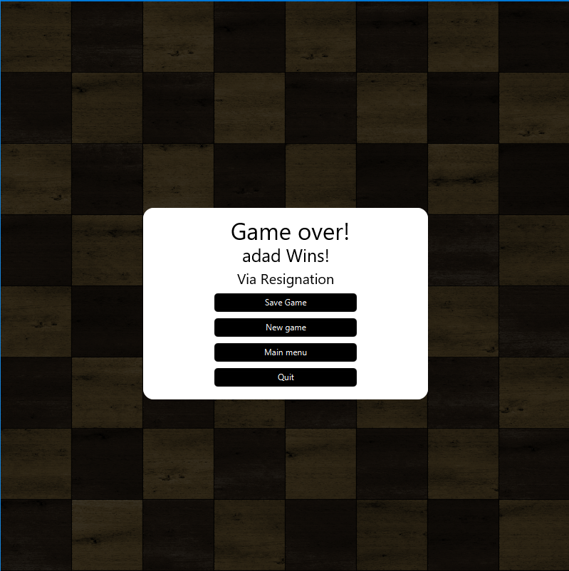
Use Case 3.1
Task 13: Resignation
Final State: Pop-up displays who won (Via Resignation)
Notes:
Asset showing the state of the board with a pop-up displaying who won and how

Slide 36
Use Case 3.1
Task 14: Offering a Draw
Action: Player presses 'ESC' key
Result: Menu appears on the screen
Notes:
Asset showing the state of the board

Slide 37
Use Case 3.1
Task 14: Offering a Draw
Action: Player presses the "Offer Draw" button
Result: Pop-up appears on screen.
Notes:
Asset showing the state of the board and the menu with all possible options (Resign, Offer Draw, and Quit)

Slide 38
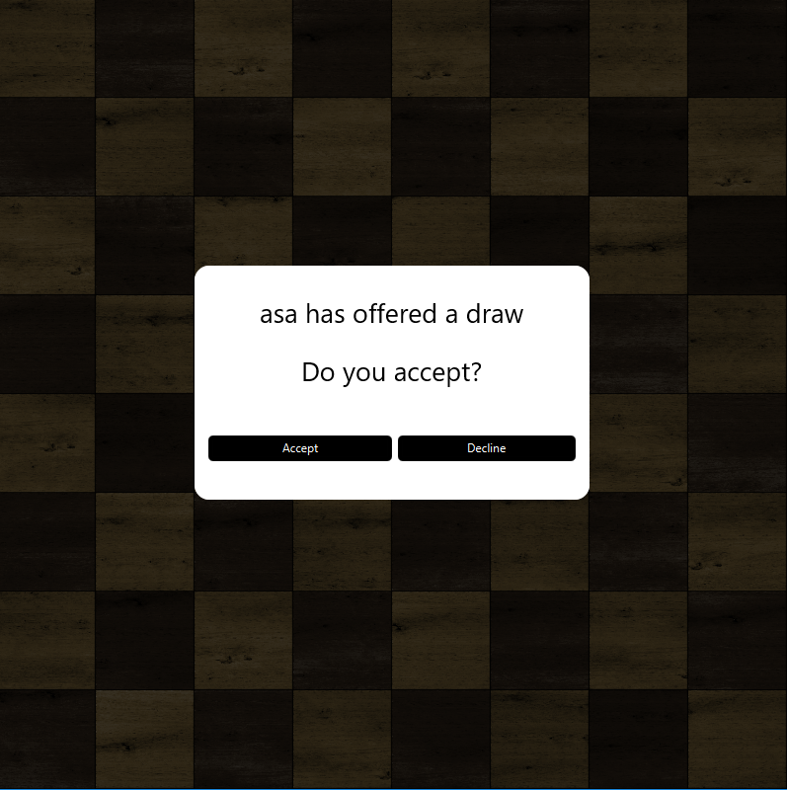
Use Case 3.1
Task 14: Offering a Draw
Final State: Pop-up displays which player is offering a draw with options to "Accept" and "Decline"
Notes:
Asset showing the state of the board and a pop-up to accept/decline draw offer

Slide 39
Use Case 3.1
Task 15: Accepting a Draw
Action: Opponent Offers a Draw (Task 14). The user selects "Accept"
Result: Pop-up appears on screen
Notes:
Asset showing the state of the board and a pop-up to accept/decline draw offer

Slide 40
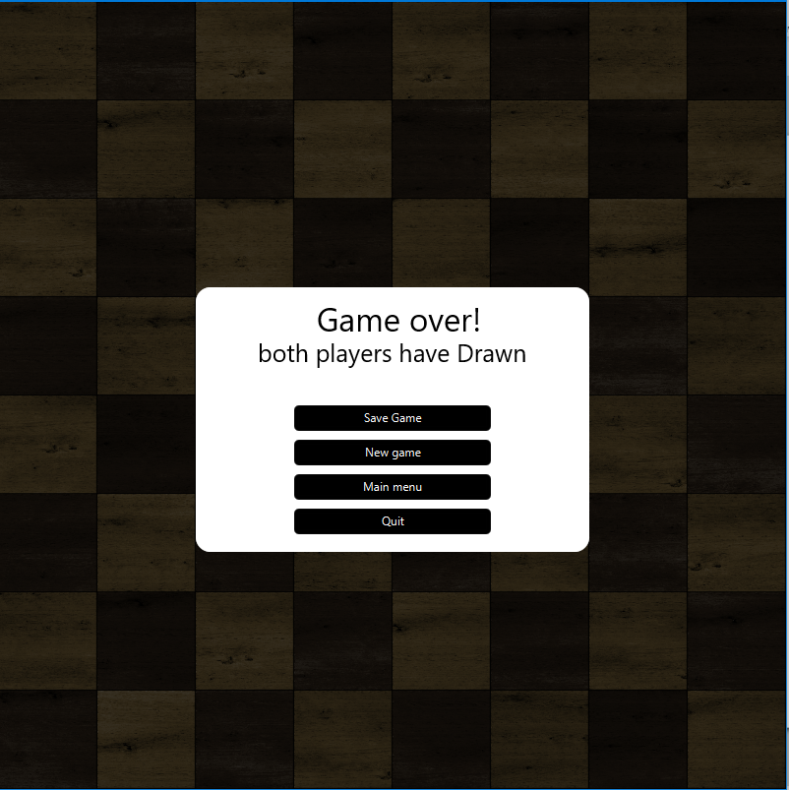
Use Case 3.1
Task 15: Accepting a Draw
Final State: Pop-up appears displaying the game ended in a draw.
Notes:
Asset showing the state of the board with a pop-up displaying the game was a draw.

Slide 41
Use Case 3.1
Task 16: Declining a Draw
Action: Opponent Offers a Draw (Task 14). The user selects "Decline"
Result: Pop-up appears on screen
Notes:
Asset showing the state of the board and a pop-up to accept/decline draw offer

Slide 42
Use Case 3.1
Task 16: Declining a Draw
Final State: Game continues to play on.
Notes:
Asset showing the state of the board

Slide 43
Use Case 3.2
Task 17: Quitting
Action: Player presses 'ESC' key
Result: Menu appears on the screen
Notes:
Asset showing the state of the board

Slide 44
Use Case 3.2
Task 17: Quitting
Action: Player selects the "Save and Quit“ / “Main Menu” option.
Result: Current chess game ends
Notes:
Asset showing the state of the board and the menu with all possible options (Resign, Offer Draw, and Quit)

Slide 45
Use Case 3.2
Task 17: Quitting
Final State: User is returned to the main menu
Notes:
Asset showing the main menu

